Slide 1

Software Design and Arcitecture(SDA) Lecture 7
Engr.Ramsha Mashood
Senior Lecturer
Department of Software Engineering
Bahria University Karachi Campus

Slide 2




Structural patterns

Slide 3

What is design pattern

Slide 4
DEFINITION
Each Pattern describes a problem which occurs over and over again, and then describes the core of the solution to that problem, in such a way that you can use that solution million times over, with out ever doing it the same way twice.
(Christopher Alexander)
(Book: Design Pattern by Erich Gamma | Richard Helm)

Slide 5
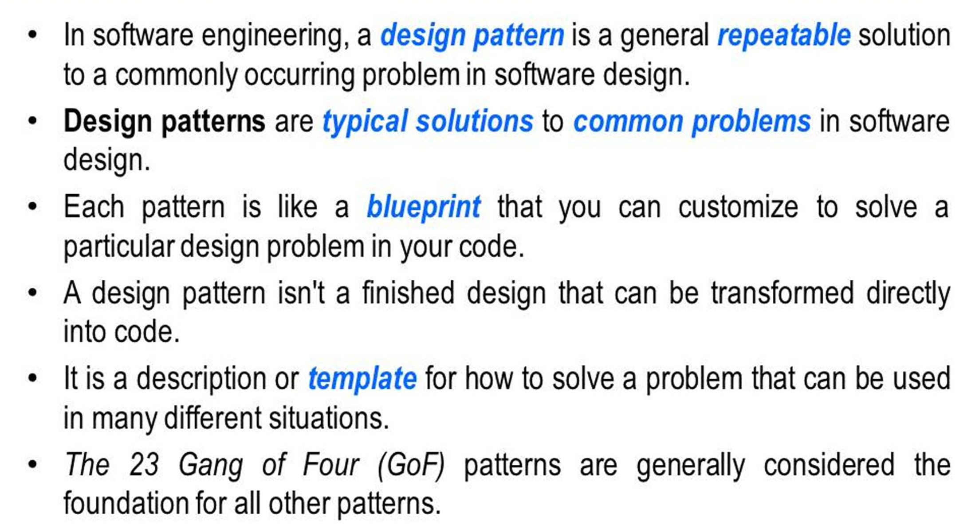
Design pattern

Slide 6
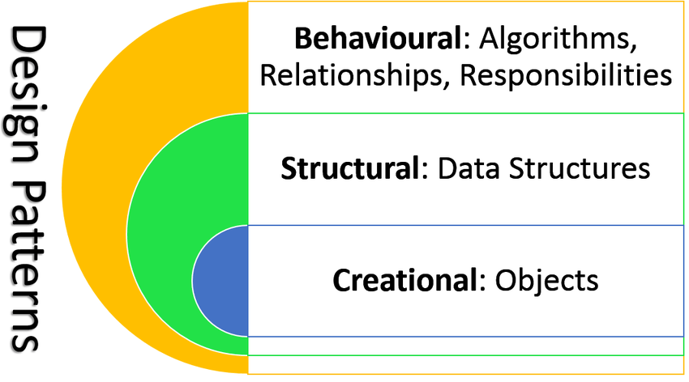

Slide 7
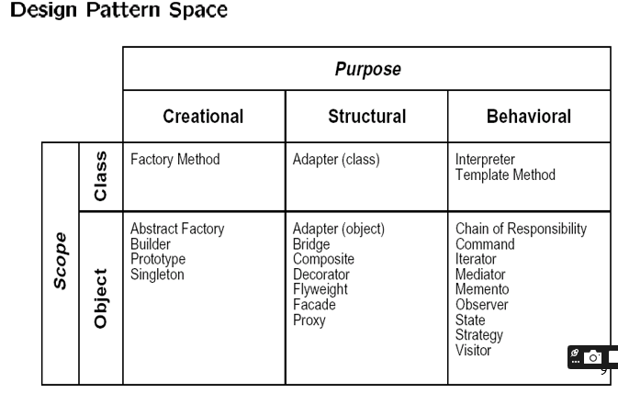

Slide 8
Classification of design patterns
Creational patterns provide object creation mechanisms that increase flexibility and reuse of existing code.
Structural patterns explain how to assemble objects and classes into larger structures, while keeping these structures flexible and efficient.
Behavioral patterns take care of effective communication and the assignment of responsibilities between objects.

Slide 9
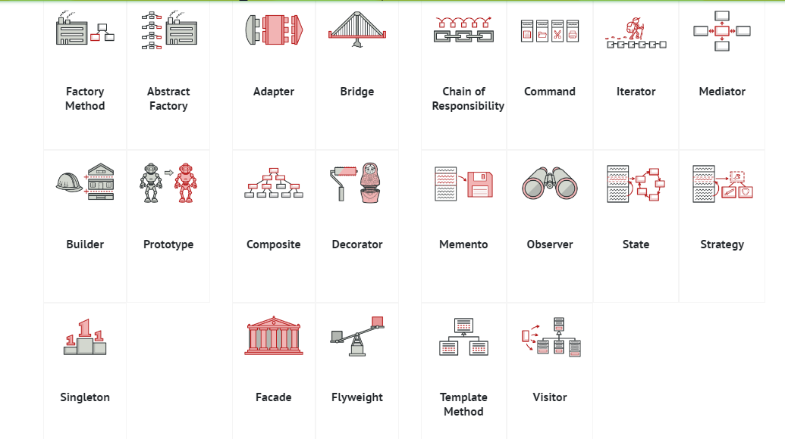
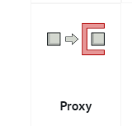
classification

Slide 10

Structural pattern

Slide 11
Facade
Facade is a structural design pattern that provides a simplified interface to a library, a framework, or any other complex set of classes.

Slide 12
FACADE
The class Facade is introduced as an interface to the whole subsystem.
Any client class needs a service from any of the subsystem classes will send the request to the facade class.
All the subsystem interfaces are combined in one class

Slide 13
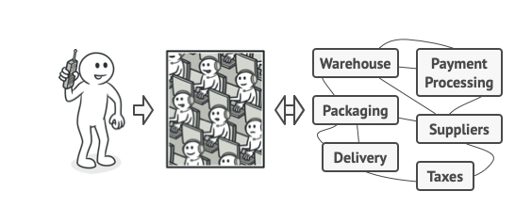
Real world analogy
When you call a shop to place a phone order, an operator is your facade to all services and departments of the shop. The operator provides you with a simple voice interface to the ordering system, payment gateways, and various delivery services.

Slide 14
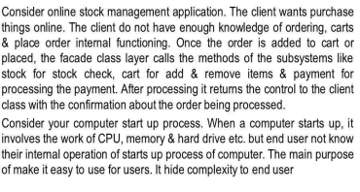
eXAMPLES

Slide 15
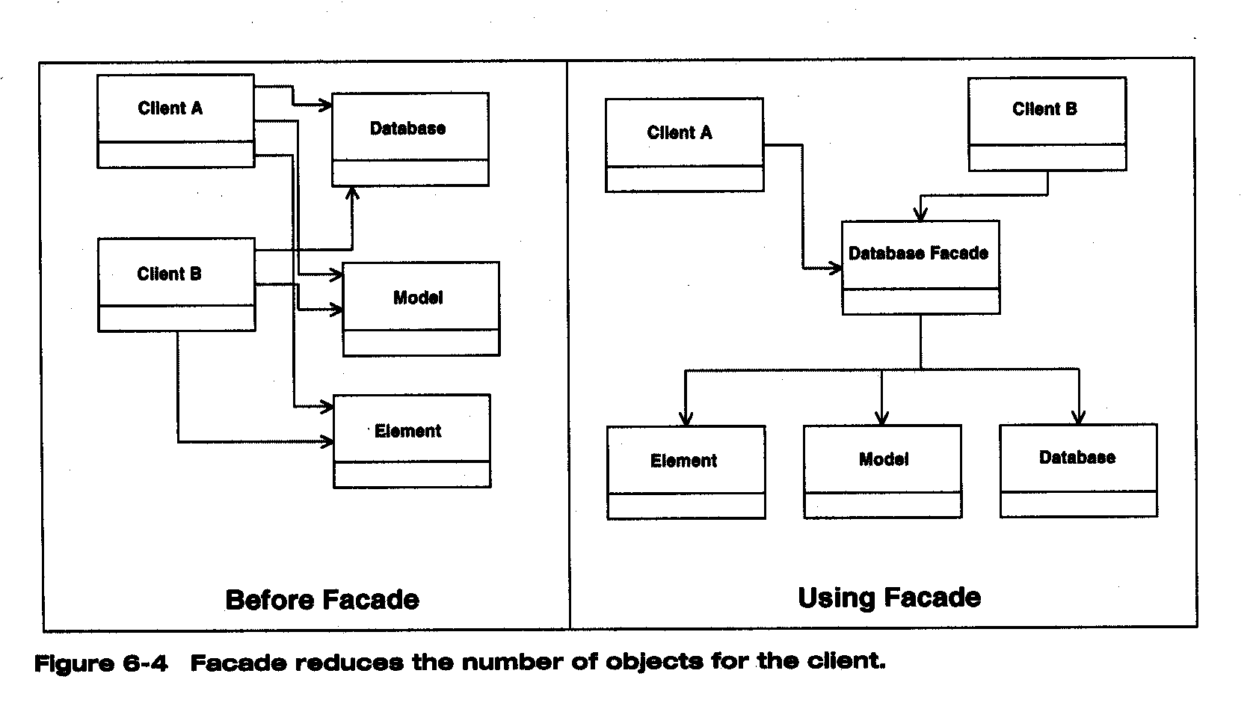

Slide 16
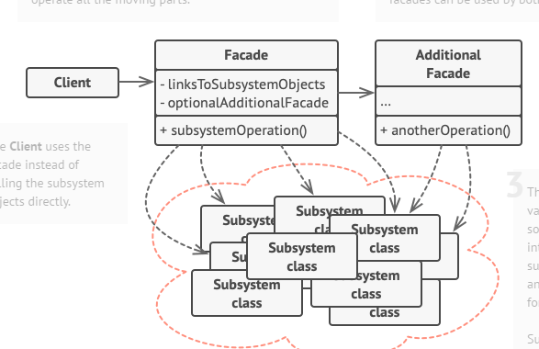
STRUCTURE

Slide 17
adAPTER
Adapter is a structural design pattern that allows objects with incompatible interfaces to collaborate.

Slide 18
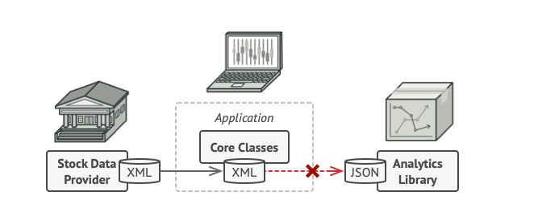
PROBLEM
Imagine that you’re creating a stock market monitoring app. The app downloads the stock data from multiple sources in XML format and then displays nice-looking charts and diagrams for the user.
At some point, you decide to improve the app by integrating a smart 3rd-party analytics library. But there’s a catch: the analytics library only works with data in JSON format.

Slide 19
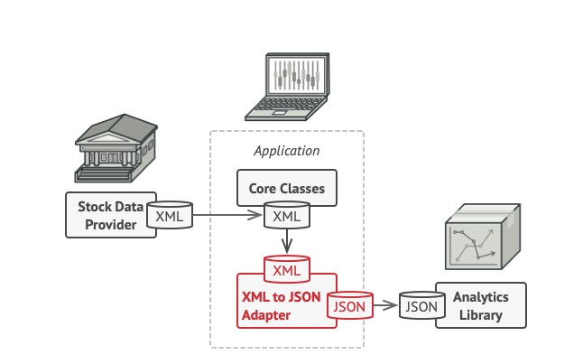
SOLUTION

Slide 20
eXAMPLE
Imagine you have an application that interacts with a database using an older version of a library. However, due to performance or feature improvements, you decide to switch to a newer version of the library. The newer version of the library may have a different interface compared to the old one, making it incompatible with your existing codebase.

Slide 21
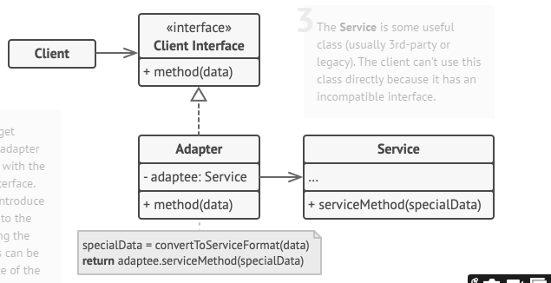
STRUCTURE

Slide 22

Bridge pattern
Bridge is a structural design pattern that lets you split a large class or a set of closely related classes into two separate hierarchies—abstraction and implementation—which can be developed independently of each other.

Slide 23
Bridge Pattern:
Definition: The Bridge Pattern decouples an abstraction from its implementation so that the two can vary independently.
Problem: When changes in one class require corresponding changes in another class, leading to a proliferation of classes.
Solution: Separate the abstraction (interface) from its implementation, allowing them to vary independently.
Scenario: Implementing various shapes with different rendering methods in a drawing application.
Real-world Analogy: Building construction, where the same design can be executed using different materials (concrete, steel, wood) depending on requirements.

Slide 24
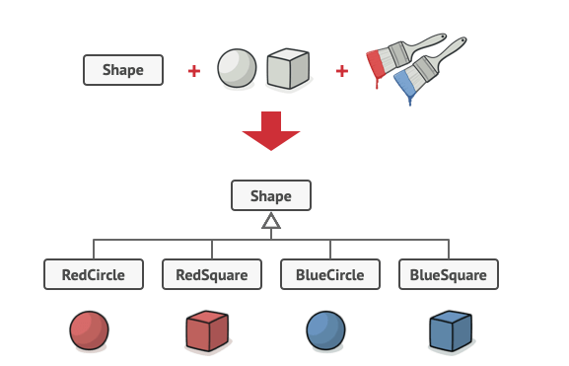
Problem

Slide 25
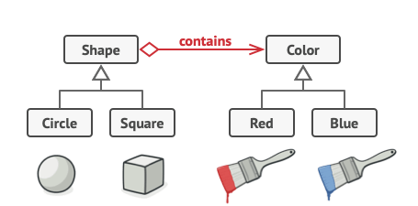
solution

Slide 26
Decorator
Decorator is a structural design pattern that lets you attach new behaviors to objects by placing these objects inside special wrapper objects that contain the behaviors.

Slide 27
Problem: Needing to add behavior or state to individual objects without affecting other objects of the same class.
Solution: Attach additional responsibilities to objects dynamically by wrapping them with decorator objects.
Scenario: Adding borders, scroll bars, or other decorations to a GUI component.
Real-world Analogy: Adding toppings to a pizza. You can start with a base pizza and then add different toppings (decorators) like cheese, pepperoni, or mushrooms.

Slide 28
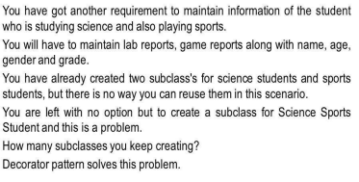
Scenario

Slide 29
Composite
The Composite Pattern composes objects into tree structures to represent part-whole hierarchies.

Slide 30
Composite Pattern:
Problem: Needing to treat individual objects and compositions of objects uniformly.
Solution: Compose objects into tree structures to represent part-whole hierarchies.
Scenario: Representing a hierarchical structure of files and directories in a file system.
Real-world Analogy: A company organizational structure, where departments contain employees and can also contain other departments.

Slide 31
Example
Armies of most countries are structured as hierarchies. An army consists of several divisions; a division is a set of brigades, and a brigade consists of platoons, which can be broken down into squads. Finally, a squad is a small group of real soldiers. Orders are given at the top of the hierarchy and passed down onto each level until every soldier knows what needs to be done.

Slide 32
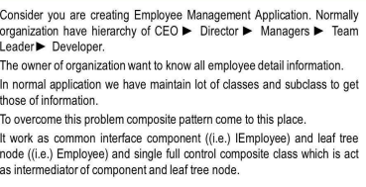
Example

Slide 33
Proxy
Proxy is a structural design pattern that lets you provide a substitute or placeholder for another object. A proxy controls access to the original object, allowing you to perform something either before or after the request gets through to the original object.

Slide 34
Problem: Needing to control access to an object due to security concerns, performance optimization, or managing the creation of expensive resources.
Solution: Create a proxy object that acts as an intermediary between the client and the real object. The proxy controls access to the real object and can perform additional tasks such as lazy initialization, caching, access control, or logging.
Scenario: Consider a scenario where a large image needs to be loaded from disk into memory for display in a user interface. Loading the entire image into memory at once may consume a lot of resources and slow down the application. Instead, a Proxy Pattern can be used where a proxy image object is created to represent the actual image. When the image is requested by the user interface, the proxy loads only the portion of the image that is currently visible on the screen, improving performance and reducing memory usage.

Slide 35
Real-world Analogy:
A security guard acting as a proxy for a building. The security guard controls access to the building, checks credentials of individuals trying to enter, and ensures that only authorized personnel are allowed inside. Similarly, a proxy object controls access to the real object and can perform additional tasks such as authentication and authorization before allowing the client to access the real object.
Consider a scenario of accessing a network resource. Instead of directly accessing the resource, which might involve heavy network traffic or authentication, a proxy can be used. The proxy can cache previously accessed data, authenticate requests, or restrict access based on permissions.

Slide 36
Useful links
https://refactoring.guru/design-patterns
https://sourcemaking.com/design_patterns

Slide 37
Continue….
Any thing to ask ??

